Slide 1
House Allocation
and Kidney Exchange

Slide 2
House allocation problems
In some matching markets, only one side of the market has preferences (or we care mostly about the preferences of one side).
Examples
  students picking housing on campus.
  students picking freshman seminars
  sports teams picking players out of college

Slide 3
House allocation problem
N individuals and N houses
Each individual has strict preference over houses.
Goal: assign each individual to a house.
What would be a “good” outcome?
An allocation is Pareto efficient if no pair of individuals, or set of individuals, can all do (weakly) better by trading houses.
Notes:
3

Slide 4
(Random) Serial Dictatorship
Each student gets a priority (perhaps randomly assigned as in the housing draw).
Students pick houses in order of their priority.
Theorem. Serial dictatorship is efficient (i.e. no mutually agreeable trades afterwards) and strategy-proof.

Slide 5
Proof
Strategy-proof
  Individual with first pick gets her preferred house, so clearly no incentive to lie.
  Individual with second pick gets her preferred house among remaining houses, so again no reason to lie.
  and so on…

Slide 6
Proof
Efficiency
  Individual with priority one doesn’t want to trade.
  Given that she is out, individual with priority two doesn’t want to trade.
  And so on….

Slide 7
Example of RSD
Three people: 1,2,3 and houses A, B, C.
Individual preferences:
  1: A > B > C
  2: A > C > B
  3: B > C > A
RSD: if order of picking is 1, 2, 3
  1 gets A, 2 gets C, 3 gets B.
  Pareto efficient? Yes.
What happens with other priority orders?

Slide 8
Top Trading Cycles
Now imagine that individuals start with a house, but the original allocation might not be efficient.
Gale’s TTC algorithm
  Each person points to most preferred house
  Each house points to its owner
  This creates a directed graph, with at least one cycle.
  Remove all cycles, assigning people to the house they are pointing at.
  Repeat using preference lists where the assigned houses have been deleted.

Slide 9


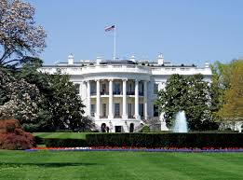
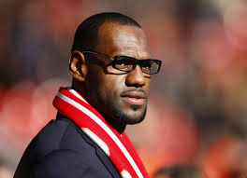

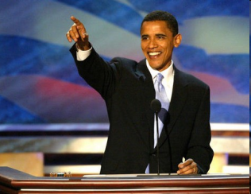



TTC in Pictures

Slide 10
Example
Preferences of people and ownership
p1: B > C > A > D | A: p1
p2: A > B > C > D | B: p2
p3: A > D > C > B | C: p3
p4: B > A > C > D | D: p4
Run the top trading cycles algorithm.

Slide 11
The Core
Consider a candidate assignment in the house problem:
  A coalition of agents blocks if, from their initial endowments, there is an assignment among themselves that they all prefer to the candidate assignment.
The core consists of all feasible unblocked assignments.
What’s the difference between core & stability?
  Stability is ex post (no more trade), core is ex ante (diff. trade)
  But closely related: generally unstable outcomes cannot be in the core because they’d be blocked by coalition of the whole.

Slide 12
Properties of TTC
Theorem. The outcome of the TTC algorithm is the unique core assignment in the housing market.

Slide 13
Proof
Core
  Blocking coalition cannot involve only those matched at round one (all agents get first choice).
  Blocking coalition cannot involve only those matched in first two rounds (can’t improve round one guys, and to improve round two guys, need to displace round one guy).
  And so on by induction.
Notes:
13

Slide 14
Proof
Uniqueness:
  Consider doing something other than assigning the round one individuals their TTC houses. They would get together and block.
  Fixing the assignments for the individuals cleared at round one of the TTC, consider an assignment that differs for the individuals that would be assigned at round 2 of TTC.
  Same argument applies. And inductively for rounds 3,4….

Slide 15
Incentives in the TTC
Theorem. The TTC algorithm is strategy-proof.
Proof. For any agent assigned at round n if truthful
No change in his report can given him a house that was assigned in earlier rounds.
No house assigned in a later round will make him better off.
So no benefit to doing anything but reporting truthfully.

Slide 16
Example of TTC
Three people: 1,2,3 and houses A, B, C.
Individual preferences and ownership
  1: A > B > C 1 Owns B
  2: A > C > B 2 Owns C
  3: B > C > A 3 Owns A
What trades take place under TTC?
  First round: 1-> A -> 3, 2 -> A -> 3, 3 -> B -> 1
  So (1,A), (3,B) are cleared, leaving (2,C).
What would be “wrong” with (1,B), (2,A), (3,C)?

Slide 17
Combining the problems
What if some individuals start with houses but some do not?
A common problem in allocating student housing
  Many universities, e.g. Michigan, Duke, Northwestern, Penn, CMU, use a variation of random serial dictatorship.
Let’s see how it works.

Slide 18
Random Serial Dictatorship with Incumbency
Each agent with a house decides whether to keep their house or enter a lottery.
  Agents who keep their house are done.
  Houses that are abandoned are available later on.
Lottery used to order newcomers and agents who gave up their house (can be completely random or favor particular agents).
Serial dictatorship applied using order from lottery and selection from available houses.

Slide 19
RSD with incumbency
There is a problem…
Existing tenants are not guaranteed to get at least as good a house as their current house!
  This may cause existing tenants to avoid the lottery and the market may not exploit all the possible gains from trade.
  Is there a way to protect existing tenants, while getting pareto efficient outcomes and maybe strategy-proofness?

Slide 20
Priority Line Mechanism
aka “you request my house – I get your turn”.
  All agents are ordered according to some priority
  Agent with top priority chooses a house, then second agent, and so on, until someone requests the house of an existing tenant.
  If the existing tenant has already chosen a house, continue. If not, insert that tenant above the requestor and re-start the procedure with the existing tenant.
  If a cycle forms, it is formed exclusively by existing tenants – clear the cycle and proceed with the priority order.

Slide 21

Priority Line in pictures

Slide 22
Properties of Priority Line
Theorem. The Priority Line mechanism is pareto-efficient, strategy-proof and makes no existing tenant worse off.
Proof. Similar to results we’ve shown (try it!)
Relationship with SD and TTC
  If there are no existing tenants: SD = Priority Line
  If everyone has a house: TTC=Priority Line
  In fact, Priority Line is just TTC except that every unoccupied house points to the agent with the (current) highest priority).

Slide 23
Example of Priority Line
Three people: 1,2,3 and houses A, B, C.
Individual preferences and ownership
  1: A > B > C
  2: A > C > B
  3: B > C > A 3 Owns A
What happens in priority line if priority is 1, 2, 3?
  1 -> A (owned by 3), so 3 -> B, match (3,B), A vacant.
  Then 1->A, so match (1,A).Leaves (2,C).
  So (1,A), (2,C), (3,B) is the final matching.

Slide 24
Summary on House Allocation
We looked at several variations
  House allocation problem
  Housing market problem
  House allocation with existing tenants
And mechanisms for each problem
  Serial dictatorship
  Top Trading Cycles
  Priority Line (TTC with a twist)
We showed that these mechanisms have desirable properties: efficiency, strategy-proof, core, etc.

Slide 25
Kidney Exchange

Slide 26
Kidney Exchange
Transplants are standard treatment for patients with failed kidneys. Transplants come from two sources
  Cadaveric transplants: donors who have died.
  Living donor transplants: typically relatives, spouses, etc.
There is a shortage of transplant kidneys.
  Wait list for a transplant has been getting longer.
  Over 90,000 patients are on the wait list.
  Roughly 20,000 transplants a year, majority cadaveric.
  In 2011, 4,720 people died while on the wait list.

Slide 27
Resolving the shortage
Buying and selling kidneys is illegal.
Section 301 of National Organ Transplant Act
  “it shall be unlawful for any person to knowingly acquire, receive or otherwise transfer any human organ for valuable consideration for use in human transplantation.”
There are probably ways to increase the supply of cadaveric kidneys (e.g. make donation the default).
We’re going to focus on ways to increase the supply of living donor kidneys.

Slide 28
Compatibility
Donor kidney must be compatible with patient
Blood type match
  O type patients can receive O kidneys
  A type patients can receive O or A kidneys
  B type patients can receive O or B kidneys
  AB type patients can receive any blood type
Also tissue type match (HLA compatibility).
Potential inefficiency: if a patient has a donor but can’t use the donor’s kidney, the donor goes home.

Slide 29
Paired Exchange
Paired exchange: match two donor-patient pairs...
  Donor 1 is compatible with Patient 2, not Patient 1
  Donor 2 is compatible with Patient 1, but Patient 2
List exchange: match one incompatible donor-patient pair and the waiting list
  Donor of incompatible pair donates to patient at the top of the waiting list.
  Patient of incompatible pair goes to the top of the wait list.

Slide 30
Do we know this problem?
Problem seems very similar to house allocation with existing tenants.
Roth, Sonmez and Unver (2004, QJE)
  The problems are (essentially) equivalent
  TTC can be used to efficiently assign kidneys.
In 2004, RSU and doctors in Boston established first clearinghouse for New England.

Slide 31
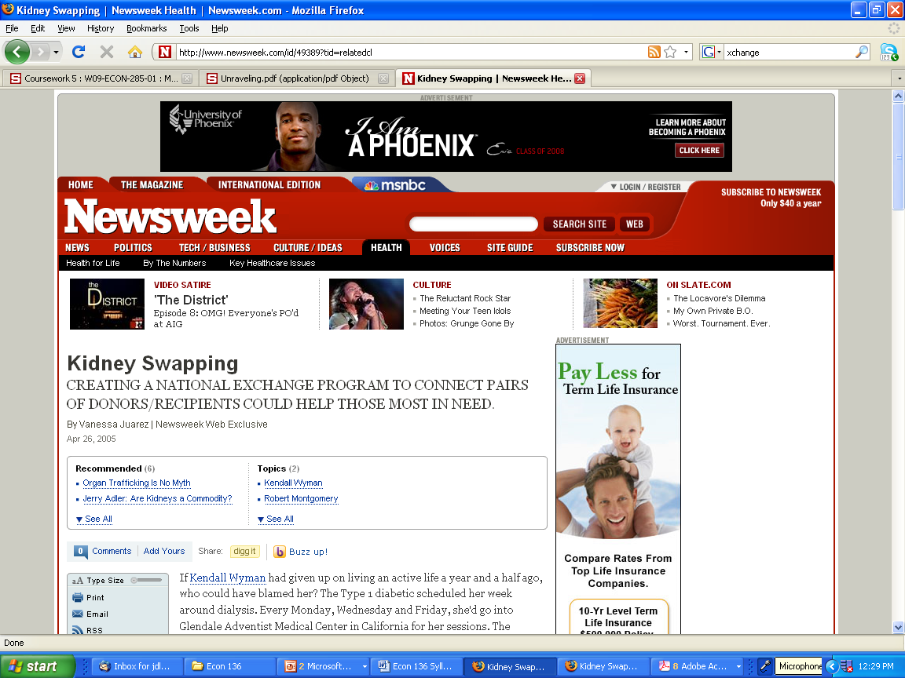

Slide 32
Exchange in practice
In practice, the problem has a few twists...
  US doctors think of compatibility as 0-1, which makes preferences different than the strict ranking in the housing model.
  At first, doctors wanted to limit to pairwise trades, and rule out list exchange.
  Compatible donors may not participate.
A slightly simplified algorithm can be used.

Slide 33
Three-Way exchange
It is possible but tricky to do multi-way exchanges, but they can help (esp. three-way).
Pair is x-y if patient and donor have blood type x-y.
Consider a population consisting of
  O-B, O-A, A-B, A-B, B-A (blood type incompatible)
  A-A, A-A, A-A, B-O (HLA incompatible)
Assume there is no HLA problem across pairs
  Two-way (A-B,B-A), (A-A,A-A), (O-B,B-O)
  Three-way: (A-B,B-A), (A-A,A-A,A-A), (B-O,O-A,A-B).

Slide 34
Gains from Three-Way
An odd number of A-A pairs can be transplanted.
O-type donors can facilitate three transplants rather than two.
In practice, O-type donors are short relative to demand, so useful to leverage them.
Four-way exchanges also can help…

Slide 35
Donor Chains
In July 2007, Alliance for paired donations started an “Altruistic Donor Chain”
Altruistic donor in Michigan donated kidney to woman in Phoenix.
Husband of Phoenix woman gave kidney to woman in Toledo.
Her mom gave kidney to patient A in Columbus, whose daugher simultaneously gave kidney to patient B in columbus.
And so on….

Slide 36

A Long Donor Chain

